Slide 1


Reporting service (RS)

Slide 2
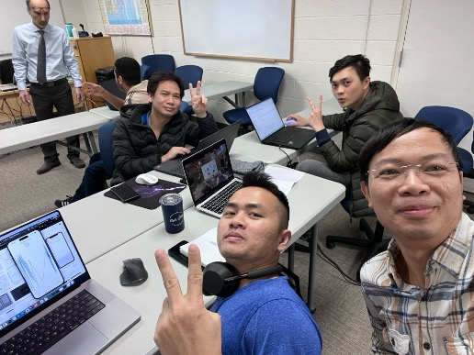
Team: PRIUS
Reporting service
Dinh Thang Nguyen
Ha Vu Duy Nguyen
Huy Toan Nguyen
Van Ty Pham

Slide 3

Agenda
Overview about RS
Team roles
Architecture
Deployment diagram & CI/CD
Technology stack
Screenshots & demo

Slide 4
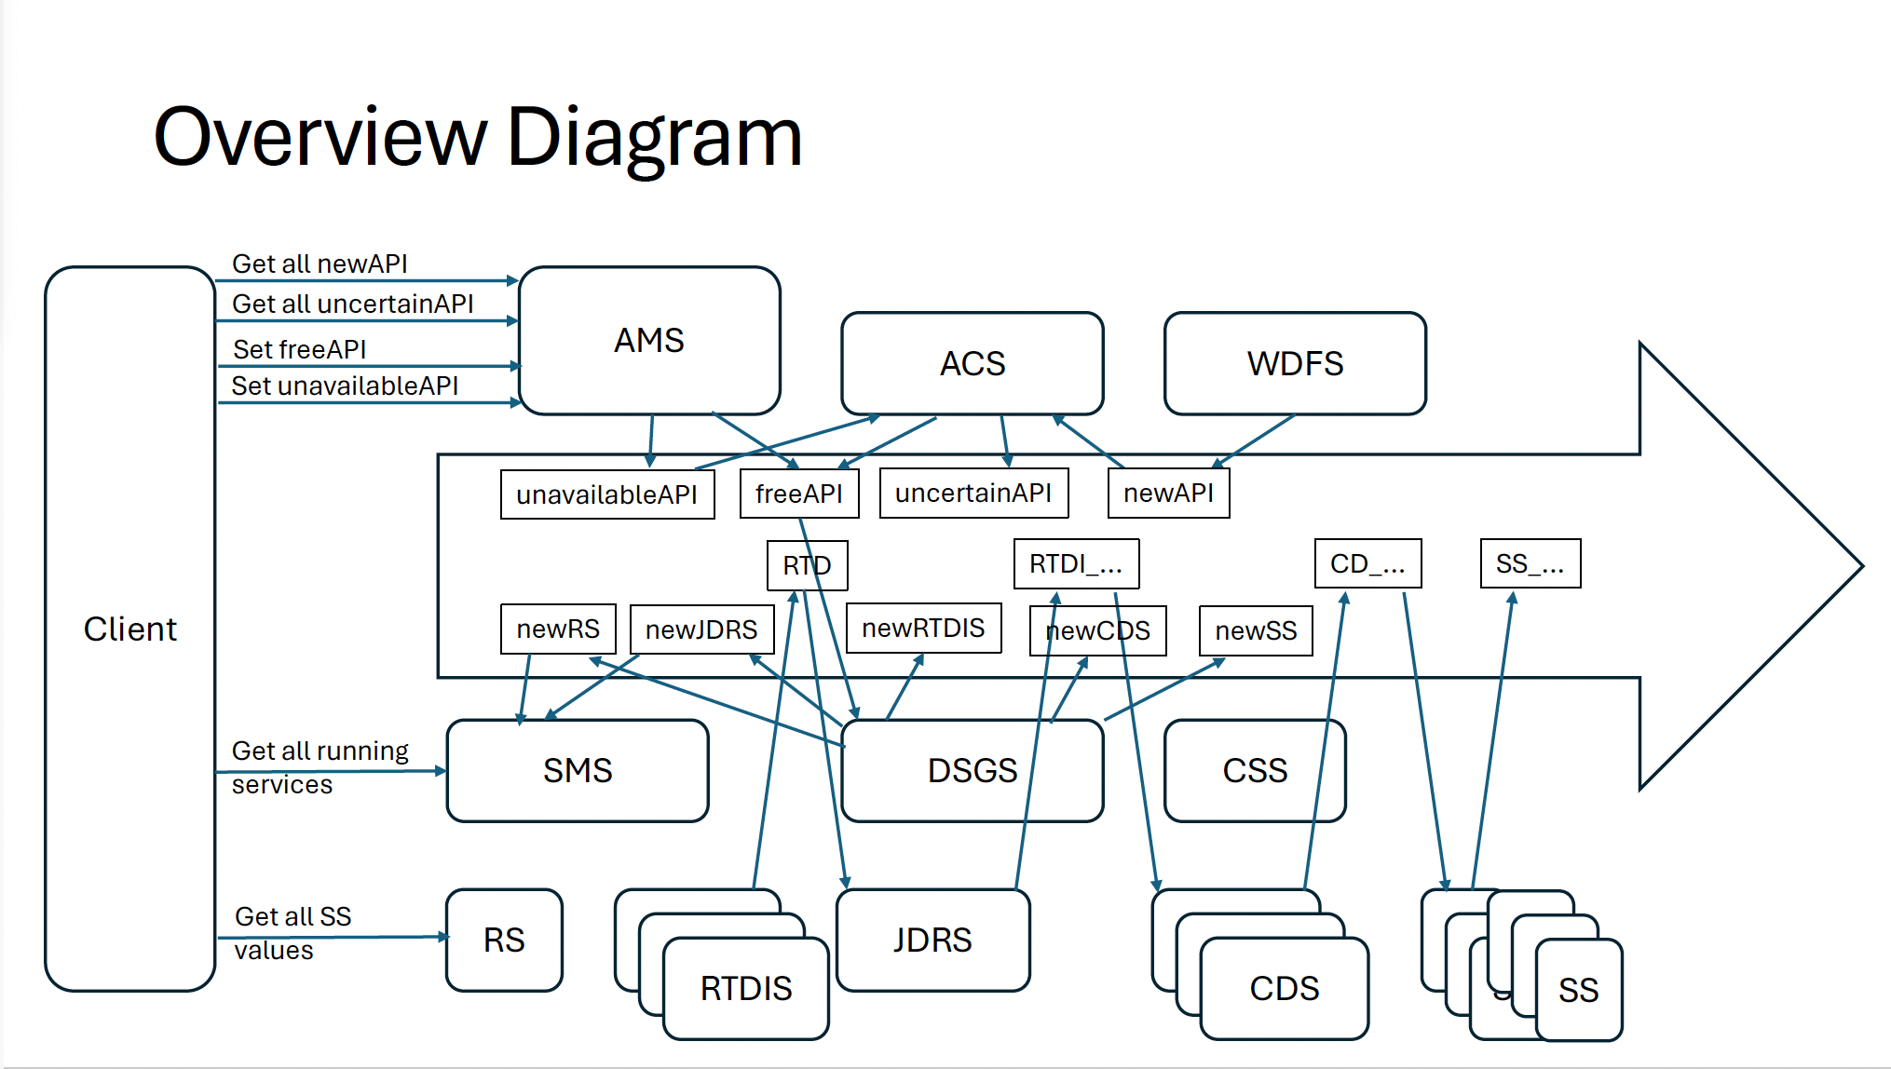
What we do in whole picture
iOS
SS_..
Web app
RS

Slide 5
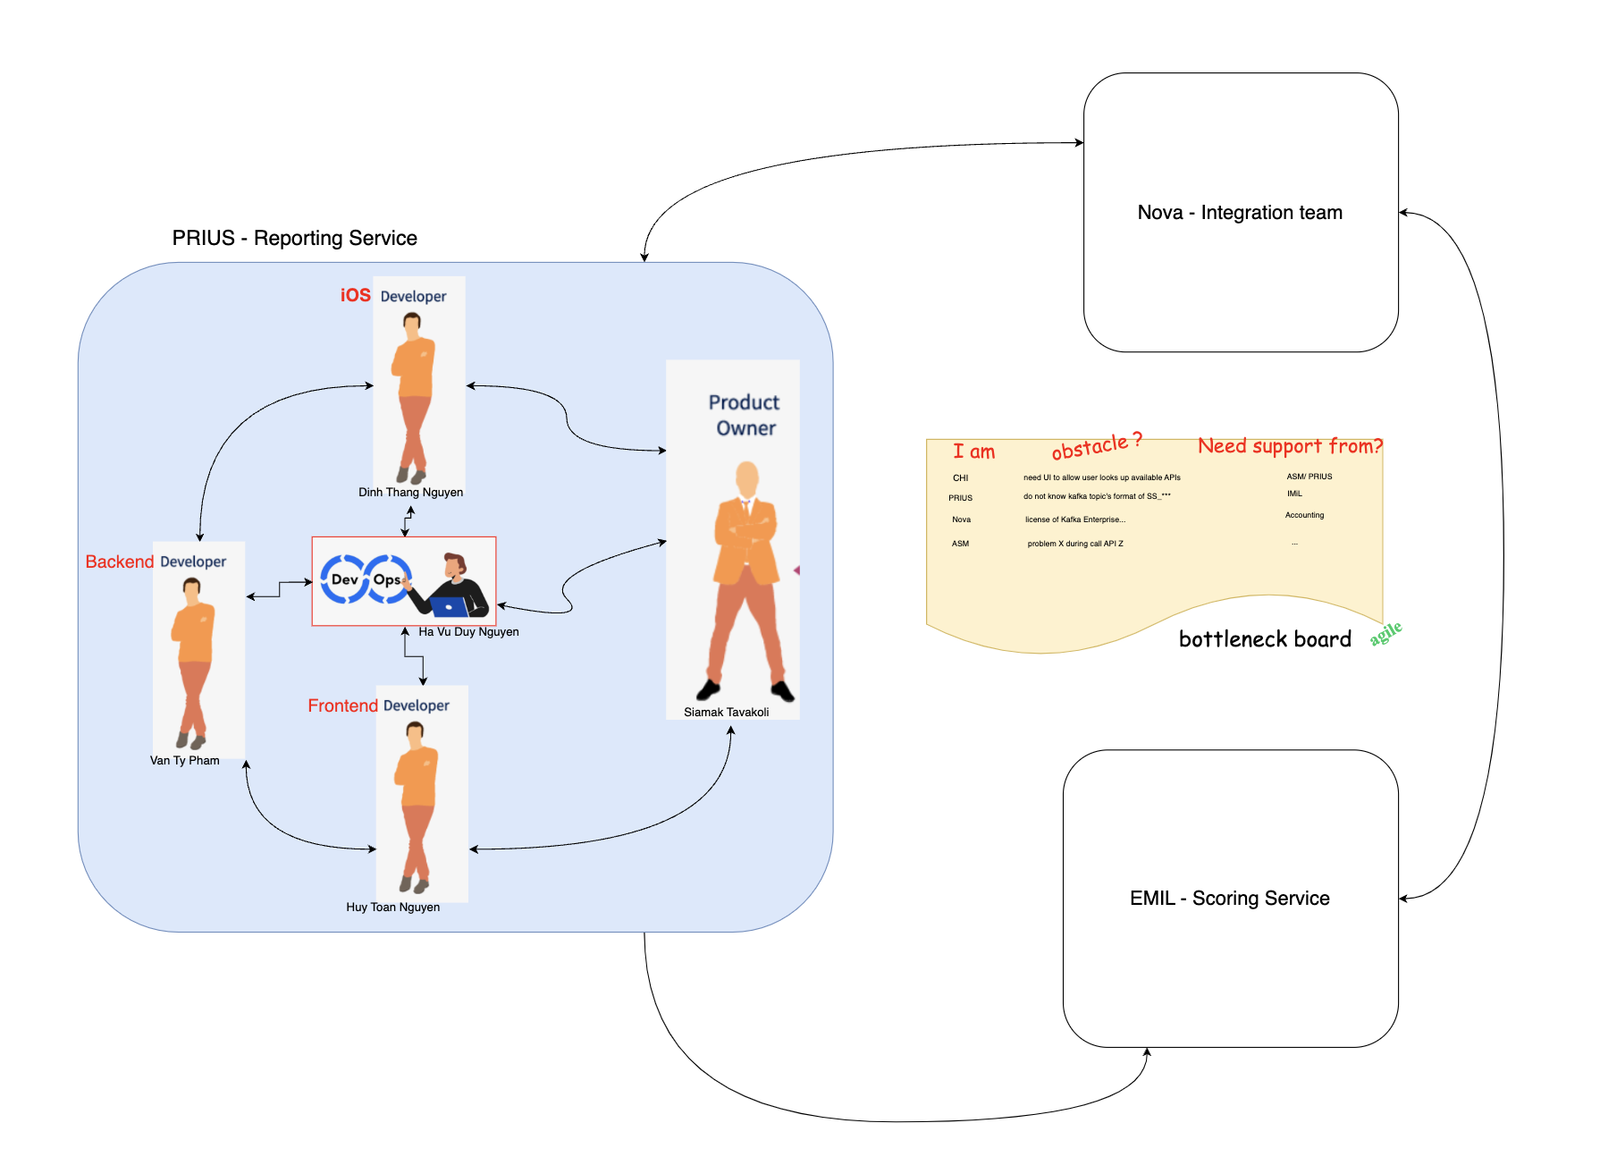
Team roles

Slide 6

Reporting service
Subscribes to the topic “SS_...” – scoring service
Serves the Client : Provides all values published by SS in the shape of a table - chart
Informs the user of all current Sensitivity Index values
Allows export of the listed information in CSV formatted file

Slide 7
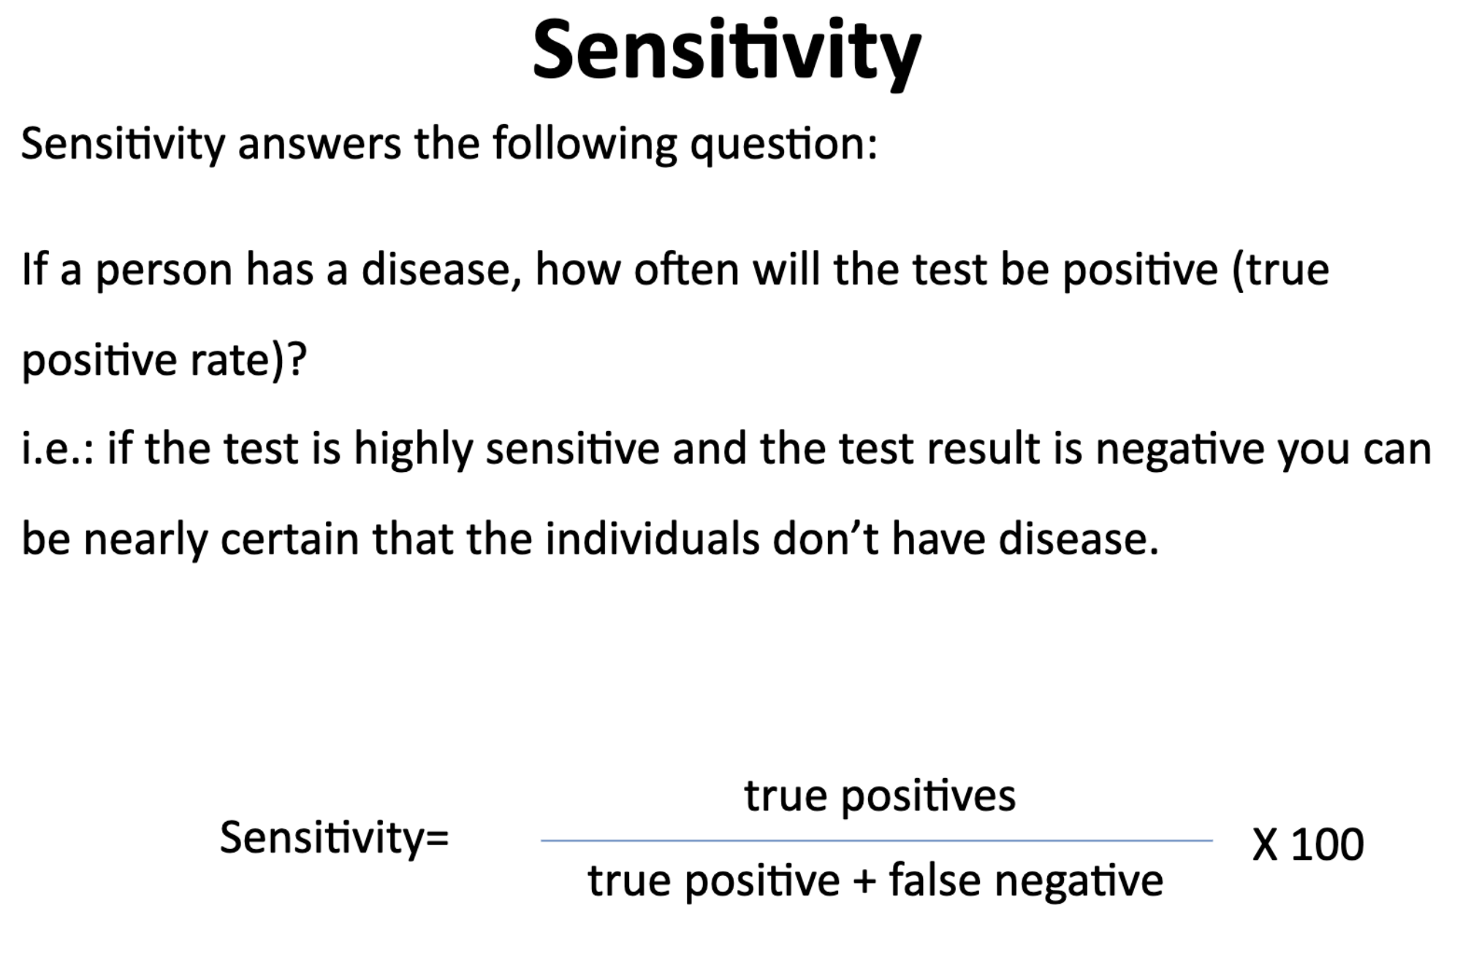
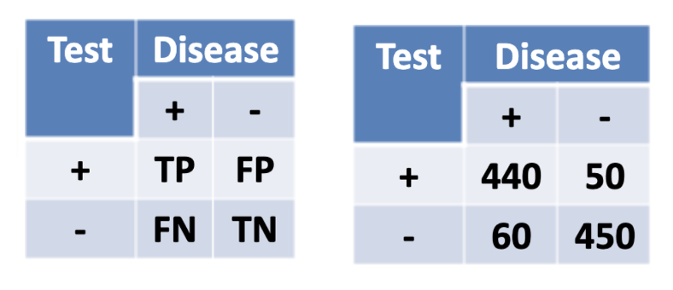
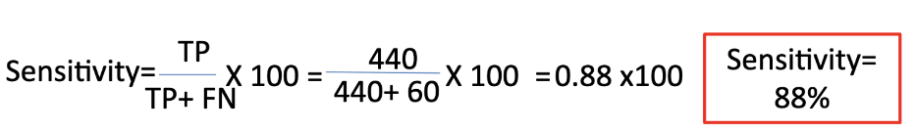
What is sensitivity ?

Slide 8
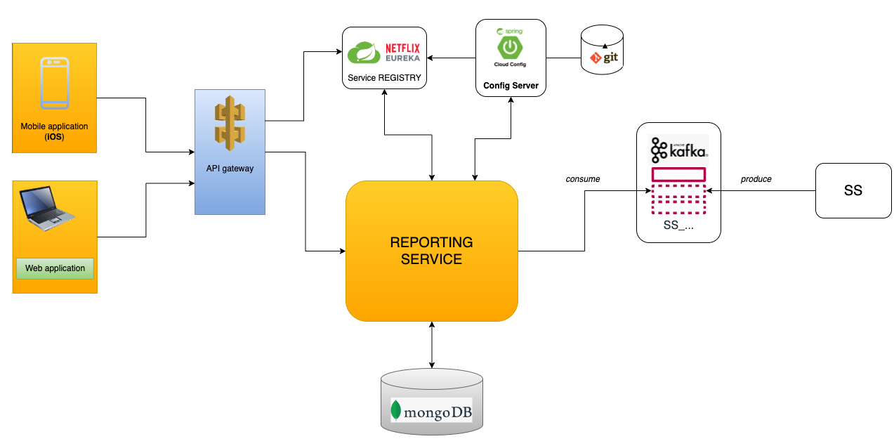
Microservice architecture

Slide 9
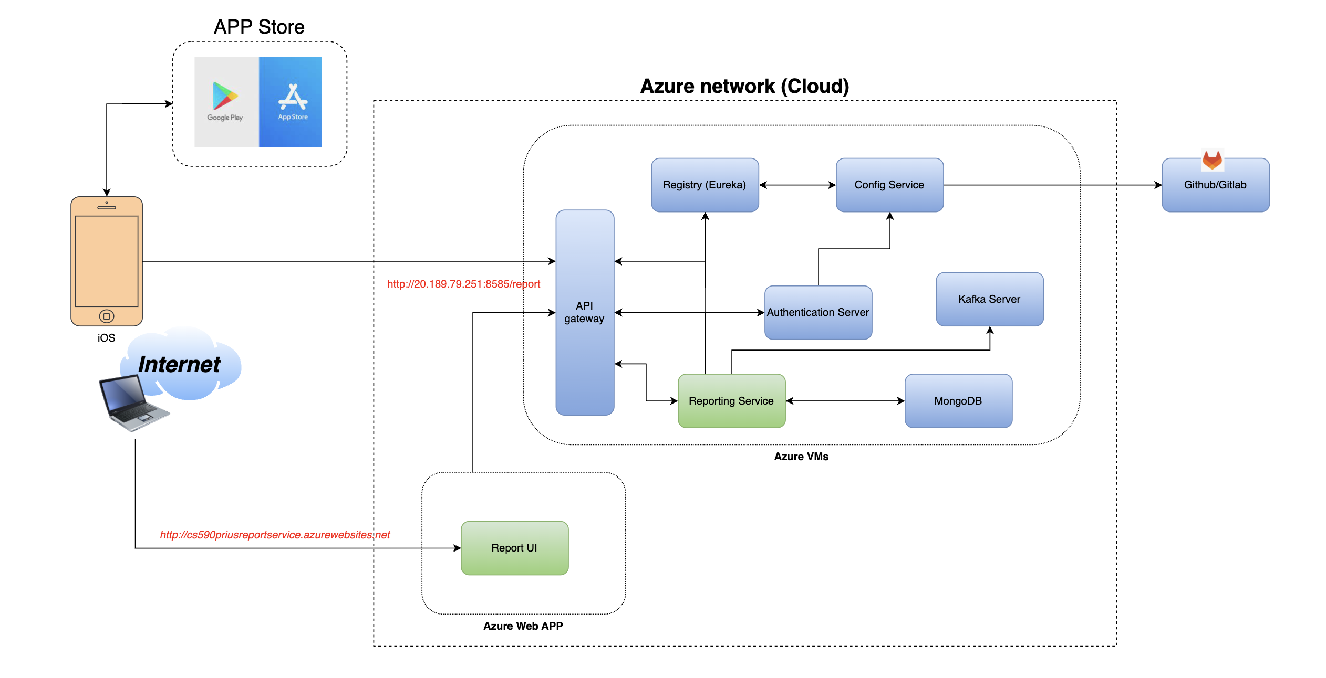
Deployment diagram

Slide 10
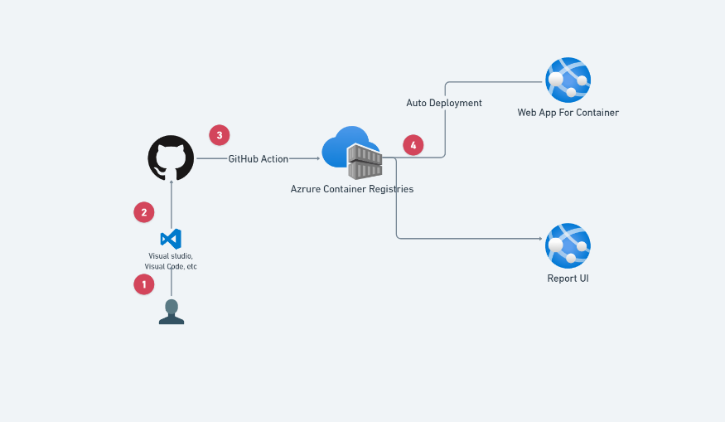
auto ci/cd

Slide 11
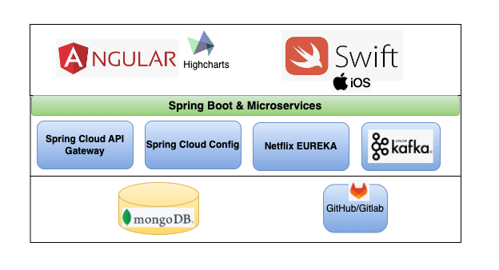
Technology stack

Slide 12

Mobile Tech stack
Combine + swiftui
Ddd
Clean architecture + MVVM
Tools (Xcode + Cocoapods)

Slide 13
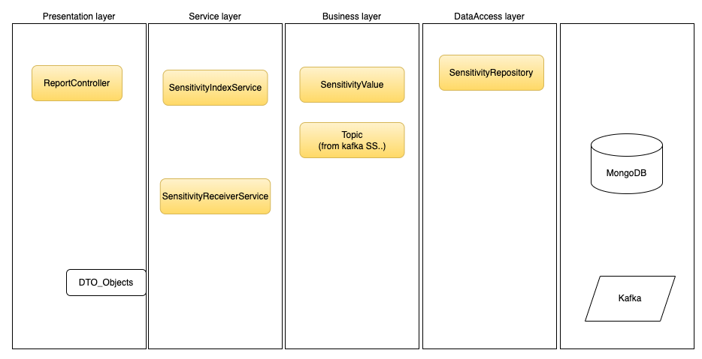
Layers in microservice - RS

Slide 14
screenshots

Slide 15
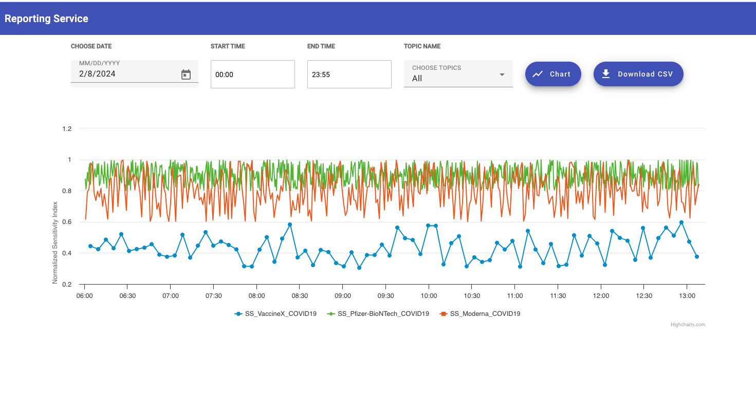
Report ui (web app)

Slide 16
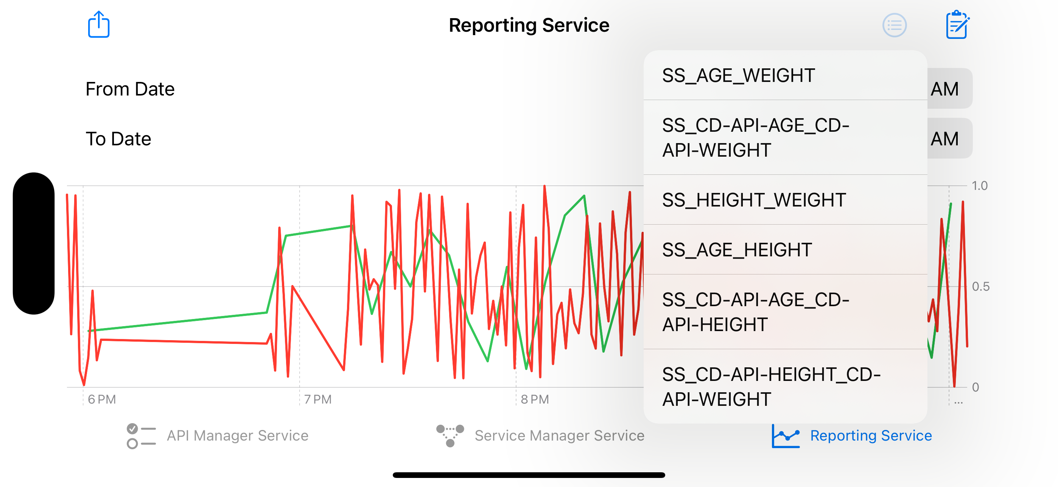
Mobile iOS app

Slide 17
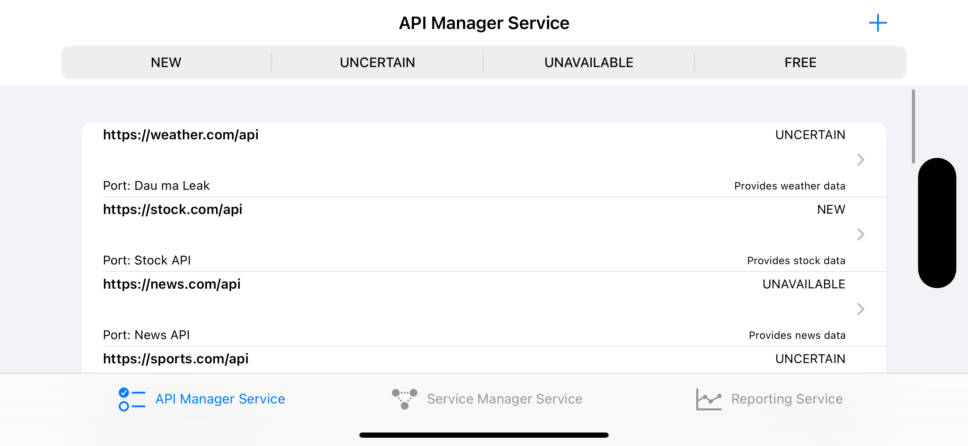
Api management ui

Slide 18
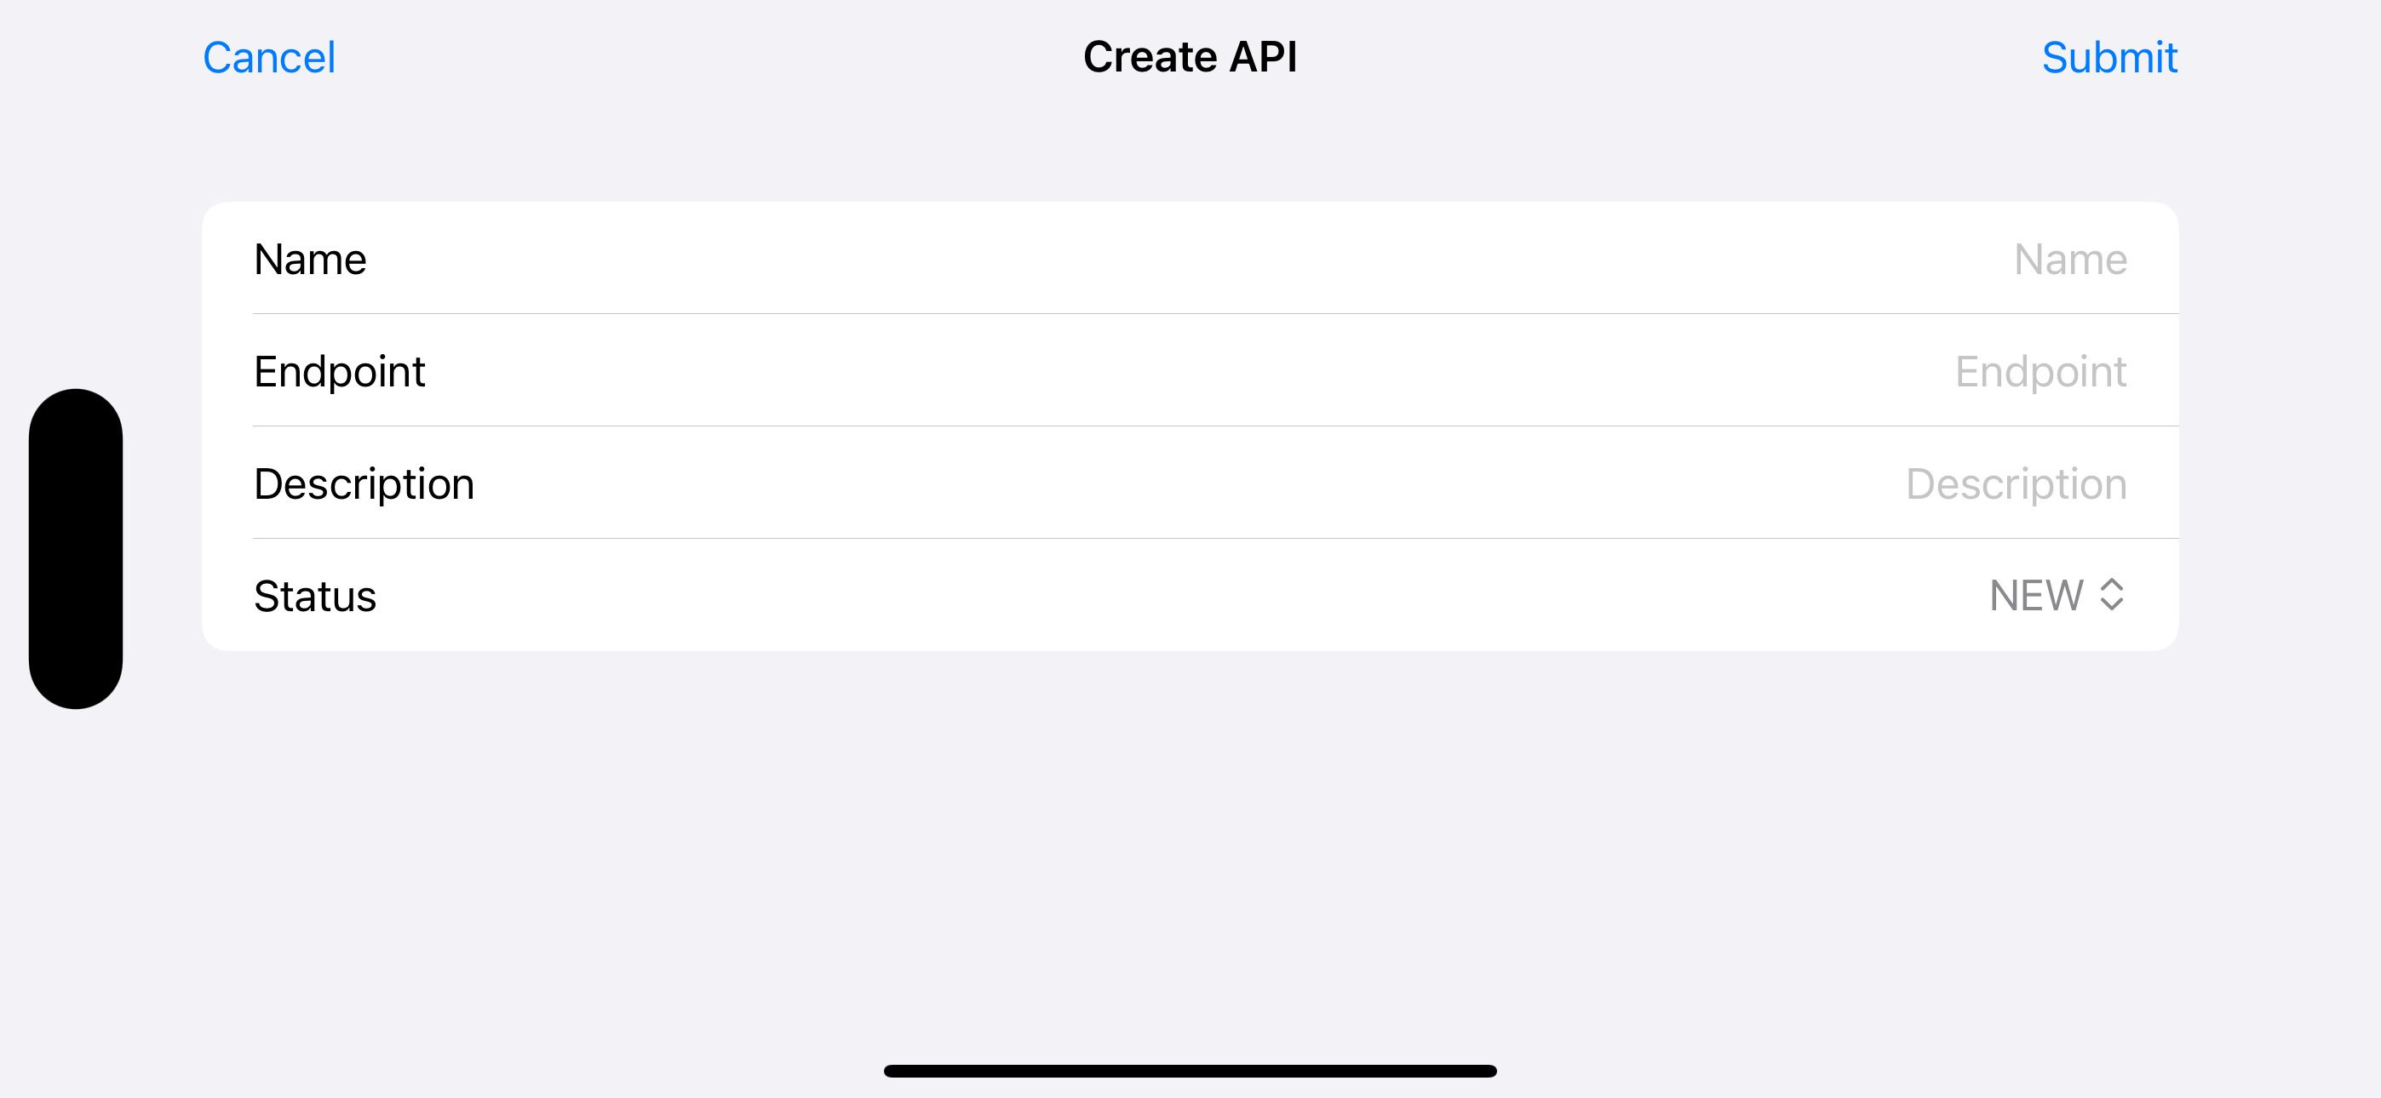
Api management ui

Slide 19
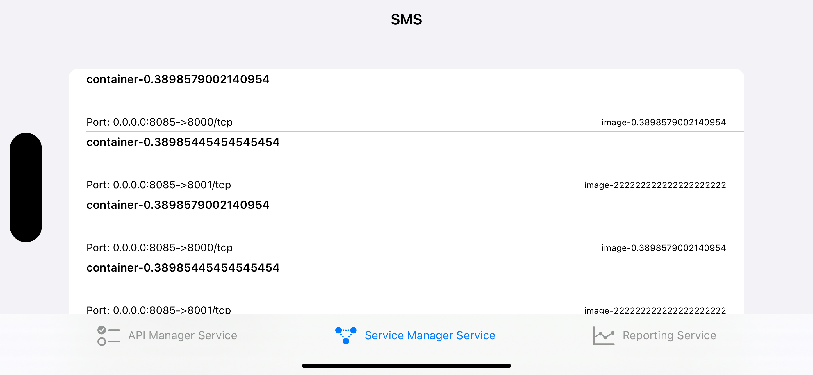
Sms ui

Slide 20

Demo
Notes:
https://nice-smoke-0a10e1c00.4.azurestaticapps.net/

Slide 21

Thank you!

